Slide 1
Smart cctv Camera
Minor Project
M.Saketh

Slide 2

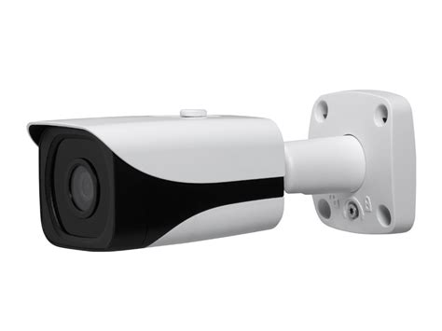

Todays’s cctv
Simply put, they are dumb
Whatever happen they just sit and watch.
Require human interaction to work properly.

Slide 3
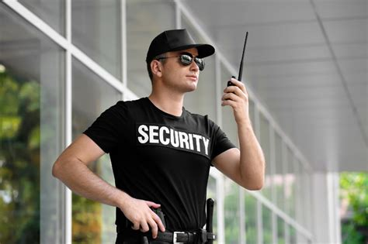
Smart cctv
Simply put it’s like a Security Guard which has sense to respond.

Slide 4
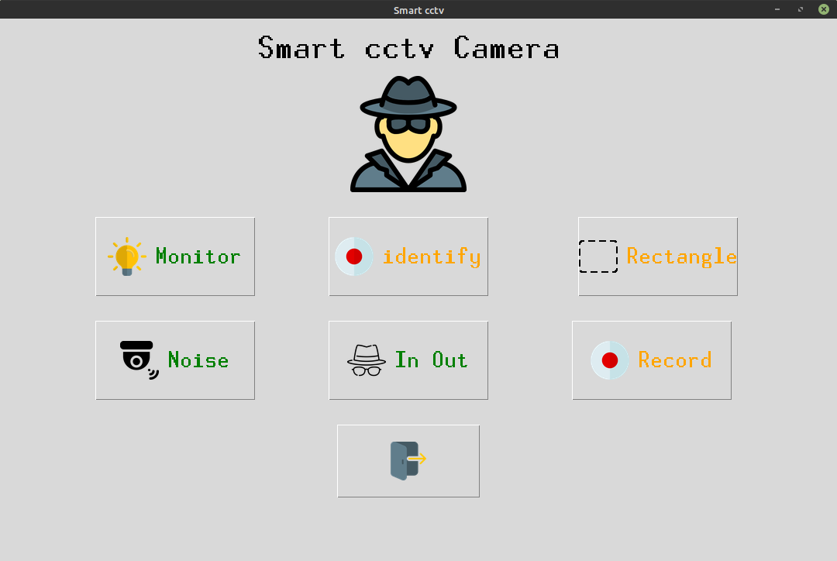
What smart cctv can do ?
What has been stolen ?
Do I know that person ?
Who entered?
Detect Noises ?
And ofcourse Record ...

Slide 5
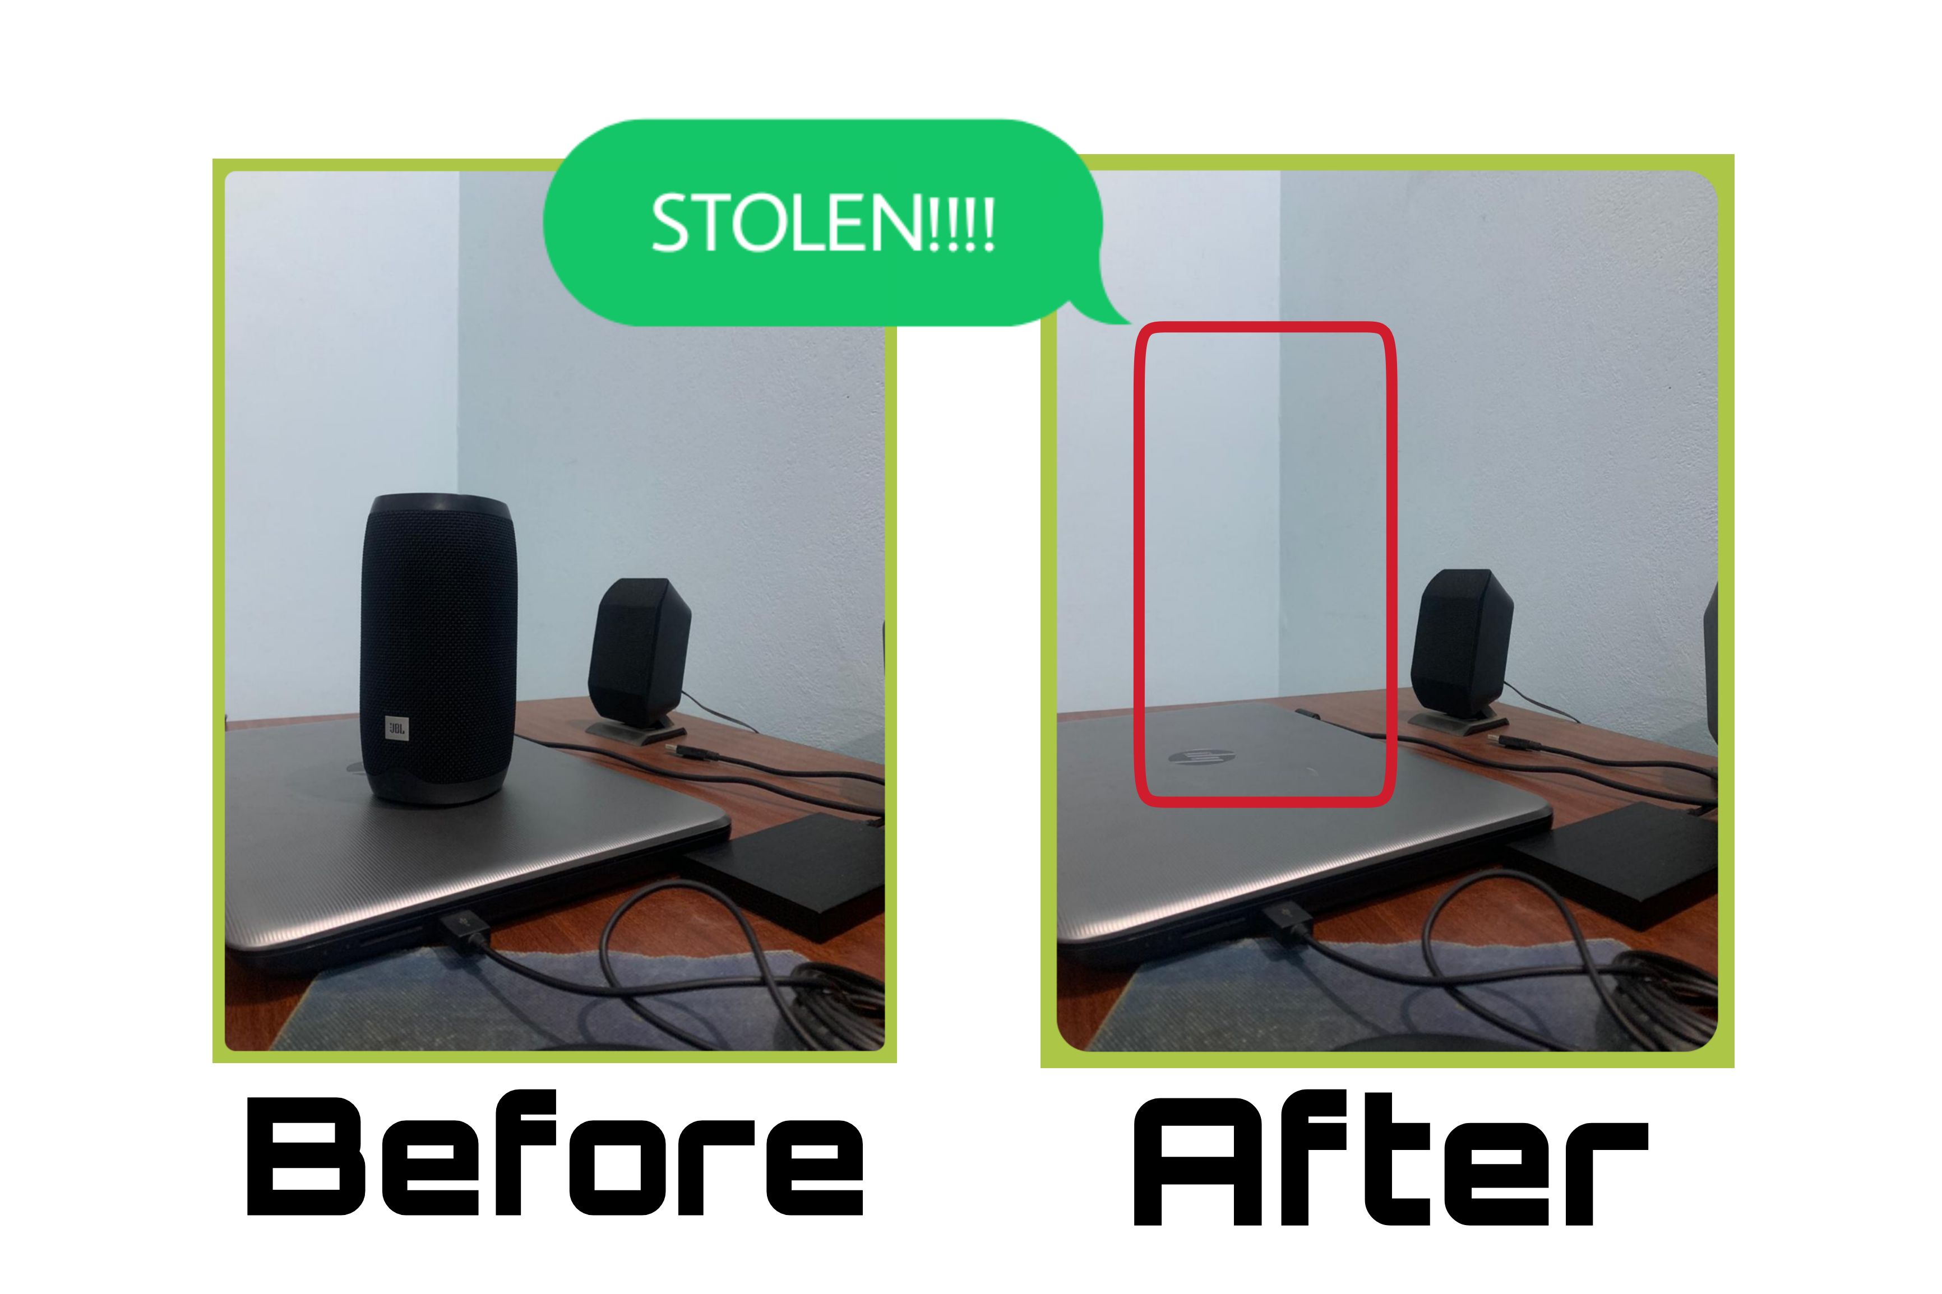
What has been stolen ?
It smartly analyze frames and find the stolen objects.
Uses Structural
Similarity.

Slide 6
Working
Initially the frame is taken when nothing is stolen
Continuosly detect for any motion happen or not
If motion happen wait until motion ends
When motion ends then capture another image
And just apply structural similarity two both of the frames.

Slide 7

Identify me !
This feature allows to train the model on known circle of us.
Next time just predict who entered
Uses LBPHFace Identifaction method.
sidhu

Slide 8
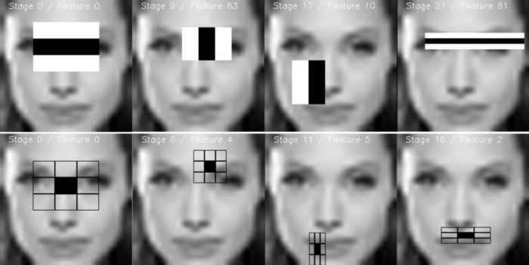
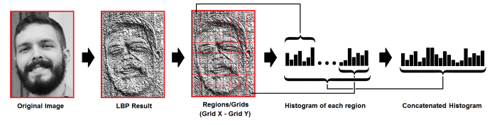
Working
First Train the model with dataset.
Second Detect for faces in frames.
Then make prediction by using trained model

Slide 9
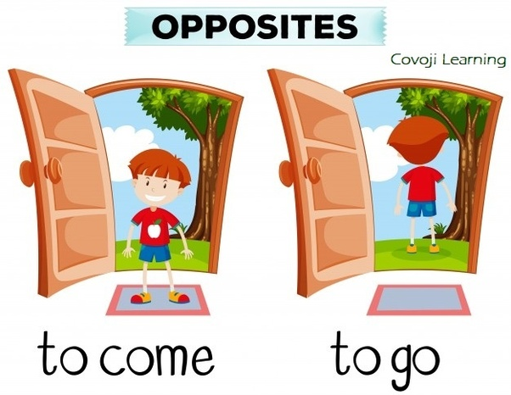
Who entered and exit ?
It just detect for noise in two ends {left, right}.
And follow the motion.
Click its picture and save ...

Slide 10
Working
Basically it just detect for motion.
And then checks the side of moiton either left or right.
If motion from left then it will check if motion ends towards right and it just captures the image
Similarly done for right side also.

Slide 11
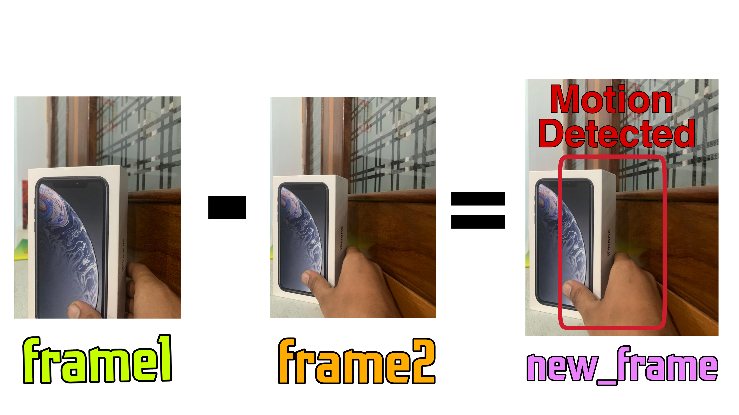
Find Noises
It captures two frames:
Frame1 and Frame2
Find absolute difference {frame2-frame1}

Slide 12
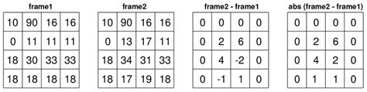
Working
It basically do absolute difference between two consecutive frames.
From that diff we detect for contours/boundaries.
If boundries are 0 then no motion and vice-versa.

Slide 13
Normal vs Smart cctv

Slide 14
Thanks

